Slide 1
Non-periodic Signal
There are infinite number of non-periodic signal.
This course will cover only the most basic one, a step.
A step is a result from on/off switches, which is common in our daily life.
On switch
9V
0V

Slide 2
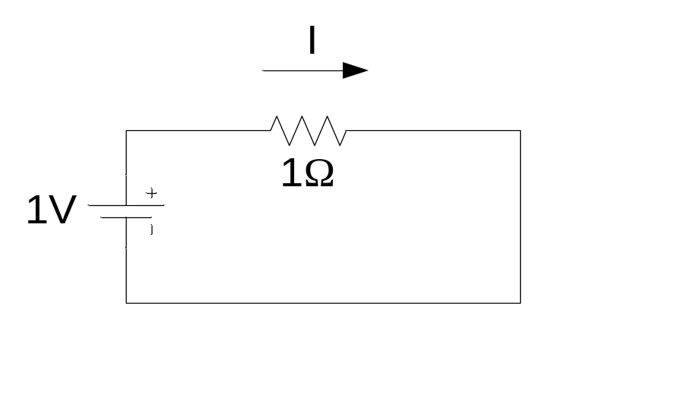

I = 1A
I = 2A
Voltage source change from 1V to 2V immediately
Does the current change immediately too?

Slide 3
Voltage
AC voltage
2V
1V
time
Current
2A
1A
time

Slide 4
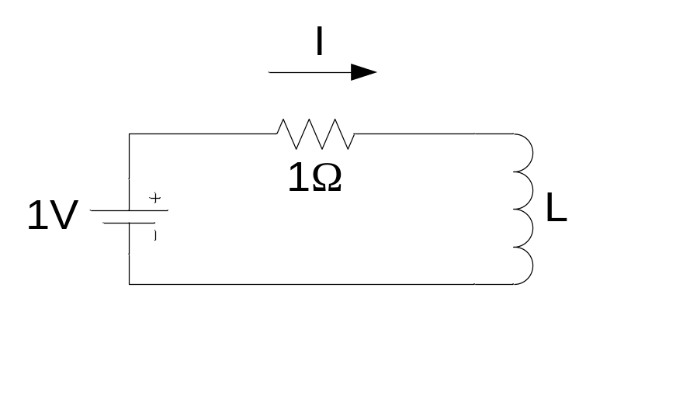

I = 1A
I = 2A
Voltage source change from 1V to 2V immediately
Does the current change immediately too?

Slide 5
Voltage
AC voltage
2V
1V
time
Current
2A
1A
Forced Response
time
Transient Response + Forced Response

Slide 6
Pendulum Example
I am holding a ball with a rope attached, what is the movement of the ball if
I move my hand to another point?
Movements
Oscillation
Forced position change

Slide 7
Transient Response or Natural Response
(e.g. oscillation, position change temporarily)
Fade over time
Resist changes
Forced Response
(e.g. position change permanently)
Follows input
Independent of time passed

Slide 8
Forced response
Natural response
at different time
Mechanical systems are similar to electrical system

Slide 9
Transient Response
RL Circuit
RC Circuit
RLC Circuit
First-order differential equation
Second-order differential equation

Slide 10
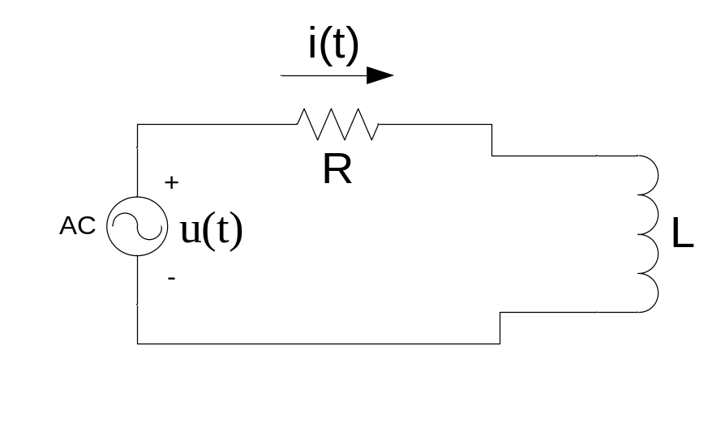
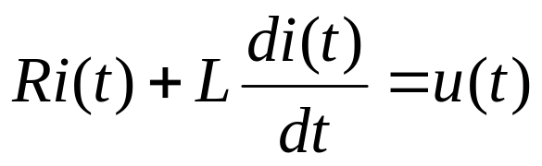
RL Circuit
KVL
First-order Differential equation
Objective: Want to solve for i(t) (in term of function of t)

Slide 11
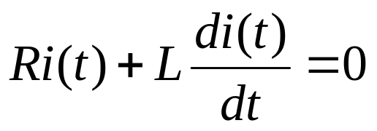
consider
Assume that i(t) = g(t) make this equation true.
However, g(t) alone may be incomplete. The complete answer is
i(t) = f(t) + g(t)
where f(t) is the answer of the equation
Voltage source go to zero

Slide 12
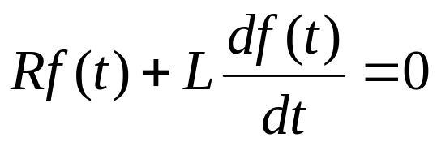
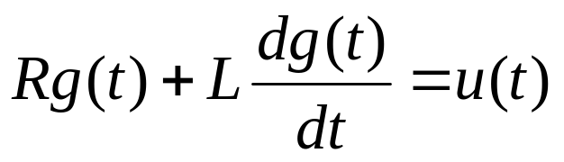
Proof: Answer has two parts
f(t) is the answer of
this equation
therefore
------------------(1)
g(t) is the answer of
this equation
therefore
------------------(2)

Slide 13
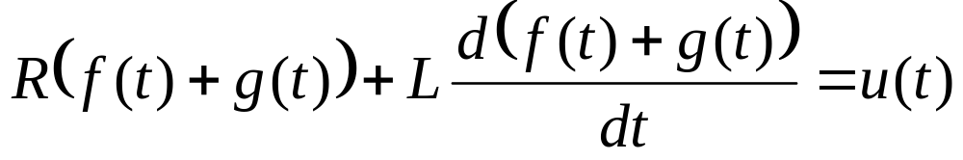
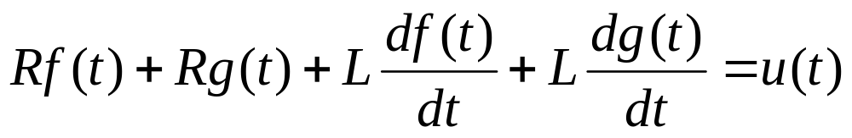
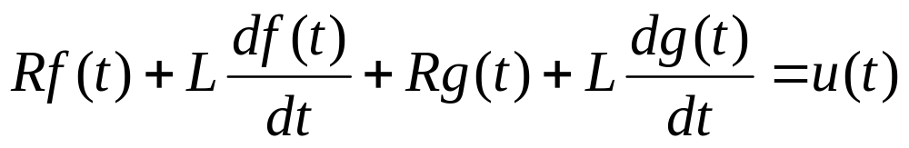
If
f(t)+g(t) is also
the answer of
this equation
therefore
must be true
from (1) = 0
which is true
from (2)

Slide 14
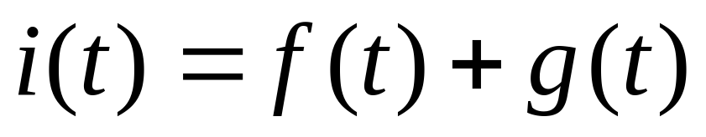
i(t) consists of two parts
Forced Response
Transient Response
Therefore, we will study source-free RL circuit first

Slide 15
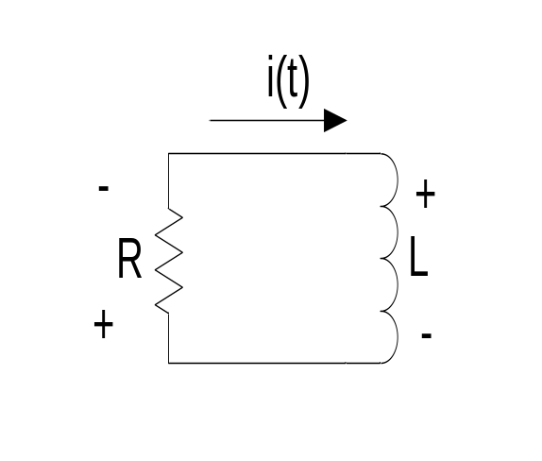
Source-free RL Circuit
Inductor L has energy stored so that
the initial current is I₀
Compare this with a pendulum
with some height (potential energy) left.
height

Slide 16
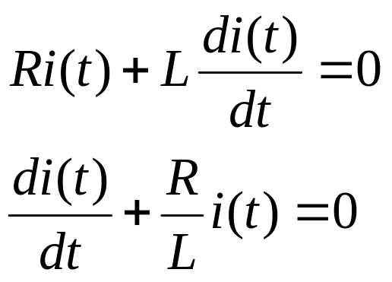
There are 2 ways to solve first-order differential equations

Slide 17

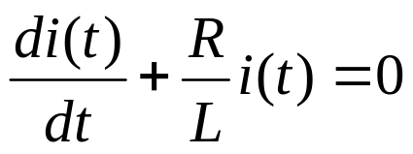
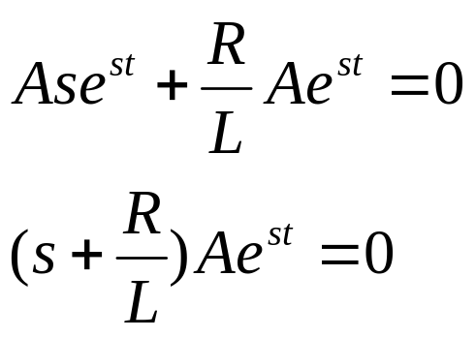
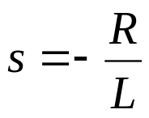
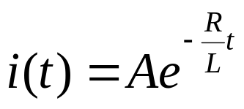
Method 1: Assume solution
where A and s is the parameters that we want to solve for
Substitute in the equation
The term that can be 0 is (s+R/L) , therefore
The answer is in format

Slide 18

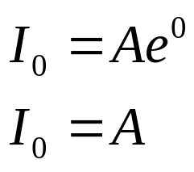
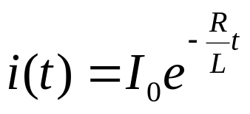
Initial condition
from
Substitute t=0, i(t=0)=0
We got

Slide 19
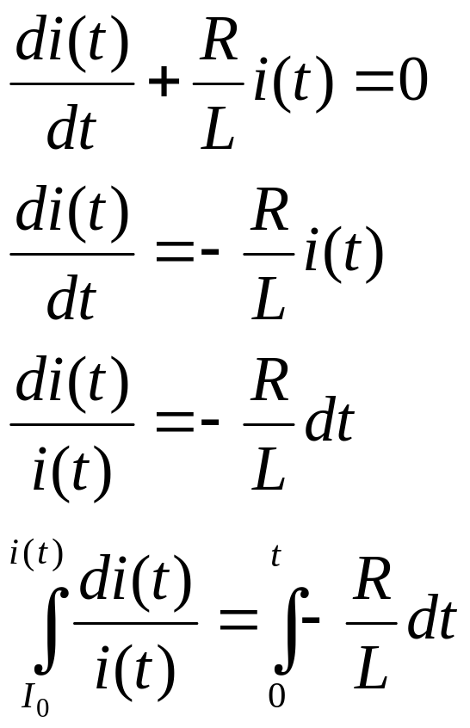
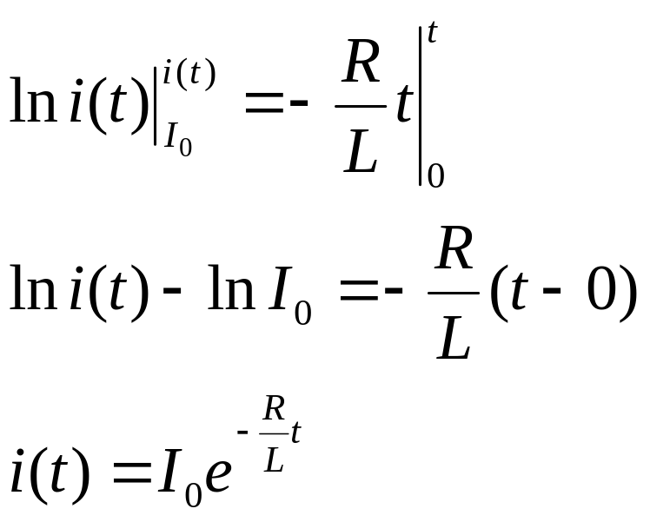
Method 2: Direct integration

Slide 20
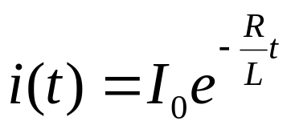
i(t)
I₀
Natural Response
of RL circuit
Approach zero
t
Natural Response only

Slide 21
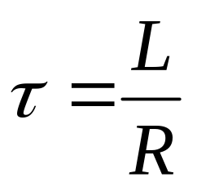
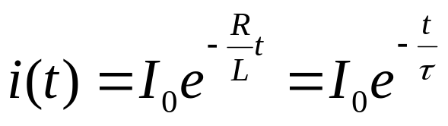

Time Constant
Ratio L/R is called “time constant”, symbol τ
Unit: second
Time constant is defined as the amount of time used
for changing from the maximum value (100%) to 36.8%.

Slide 22
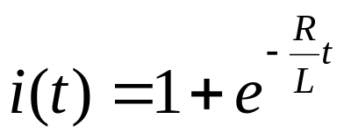
i(t)
Forced Response
2A
Natural Response
1A
Approach 1A
t
Forced response = 1A comes from voltage source 1V
Natural Response + Forced Response

Slide 23
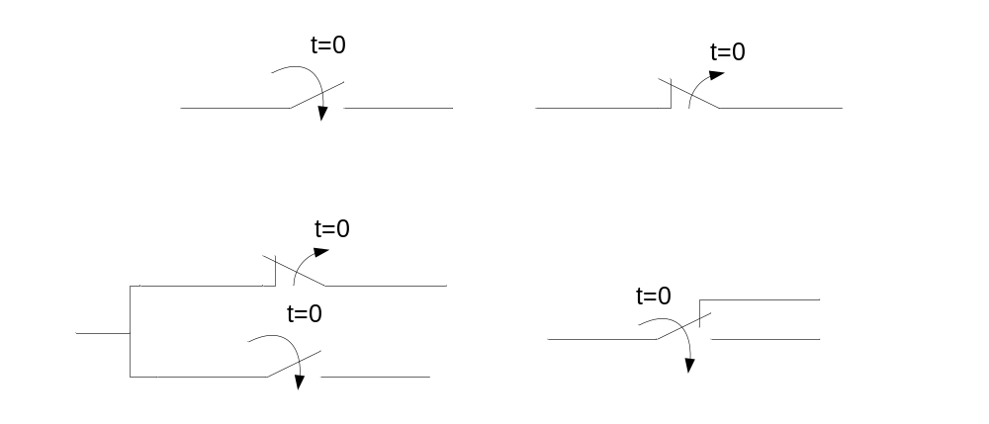
Switch
Close at t =0
Open at t =0
t < 0
3-way switch

Slide 24
Switch
Close at t =0
Open at t =0
t > 0
3-way switch

Slide 25
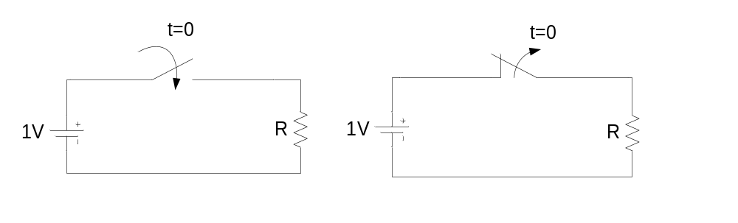
v(t)
v(t)
1V
1V
0V
0V
t
t
Step function (unit)

Slide 26
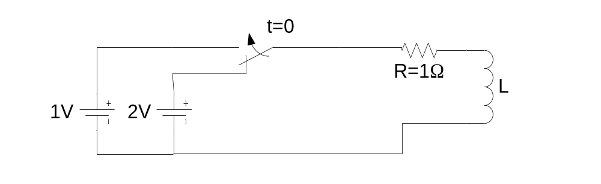
Will divide the analysis into two parts: t<0 and t>0
When t<0, the current is stable at 2A. The inductor acts like
a conductor, which has some energy stored.
When t>0, the current start changing. The inductor discharges energy.
Using KVL, we can write an equation of current with constant
power supply = 1V with initial condition (current) = 2A

Slide 27
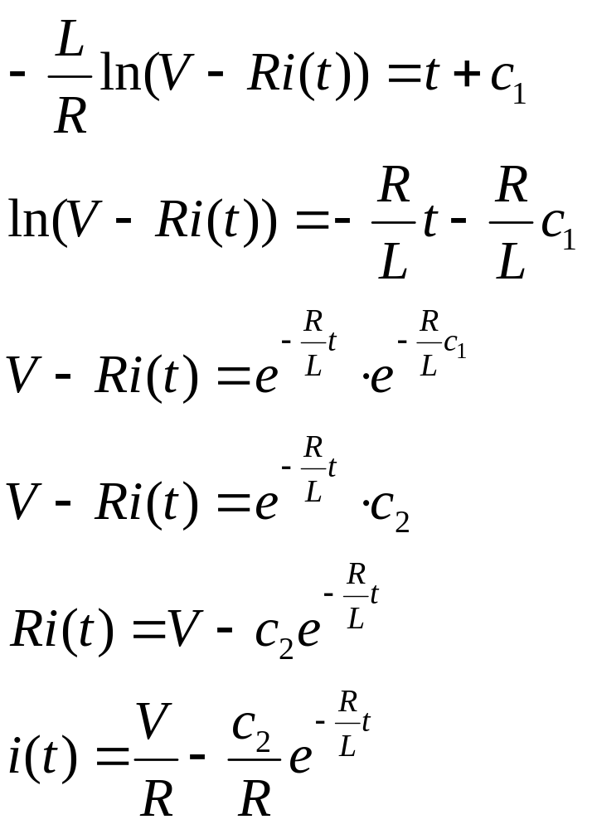
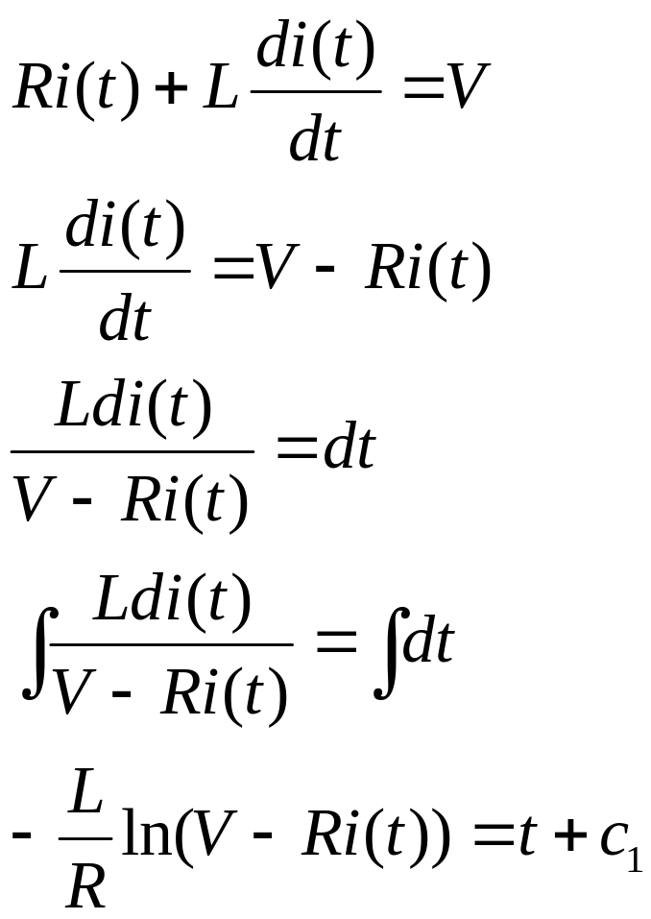
For t>0

Slide 28
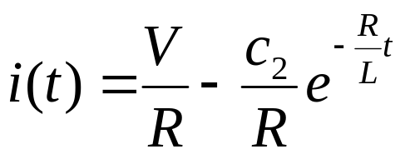
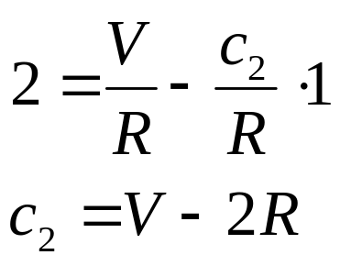
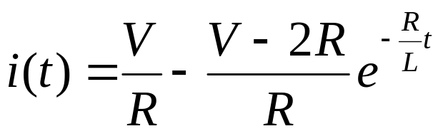
We can find c2 from initial condition
i(0) = 2 A
Substitute t = 0, i(0) = 2
Therefore, we have
Forced Response
Substitute V=1, R=1
Natural Response

Slide 29
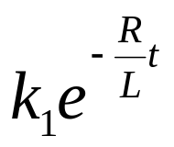
RL Circuit Conclusion
Force Response of a step input is a step
Natural Response is in the form
where k1 is a constant, whose value depends on
the initial condition.

Slide 30
How to Solve Problems?
Divide in to several periods (3 periods as shown below)
Period 1, 3 have constant V, I -> Use DC circuit analysis
Period 2 is transient.
Response
Period 1
Period 2
Period 3
time

Slide 31
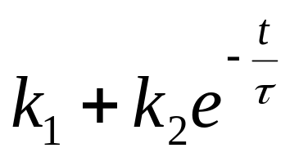
Calculate Transient (period 2)
Start by finding the current of the inductor L first
Assume the response that we want to find is in form of
Find the time constant τ (may use Thevenin’s)
Solve for k1, k2 using initial conditions and
status at the stable point
From the current of L, find other values that the problem ask

Slide 32
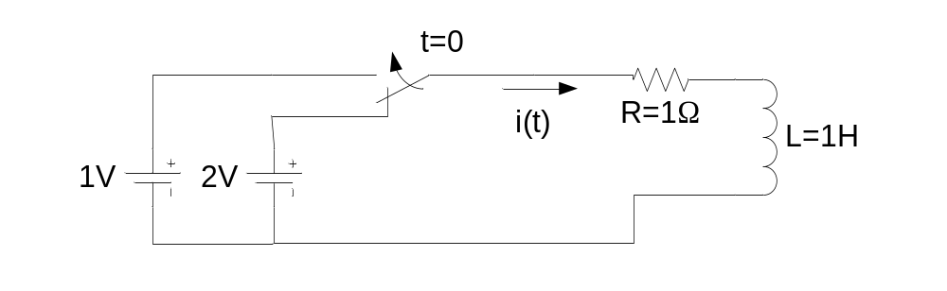
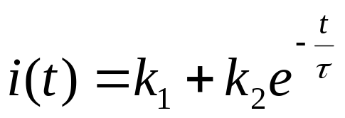
Example
The switch is at this position for a long time
before t=0 , Find i(t)
Time constant τ = 1 sec

Slide 33
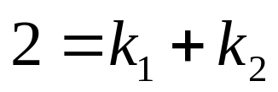
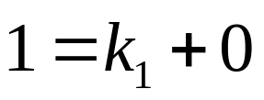
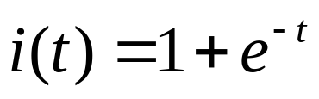
At t=0, i(0) = 2 A
At t = ∞, i(∞) = 1 A
Therefore, k1 = 1, k2 = 1
The answer is

Slide 34
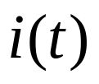
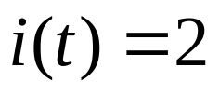
2A
1A

Slide 35
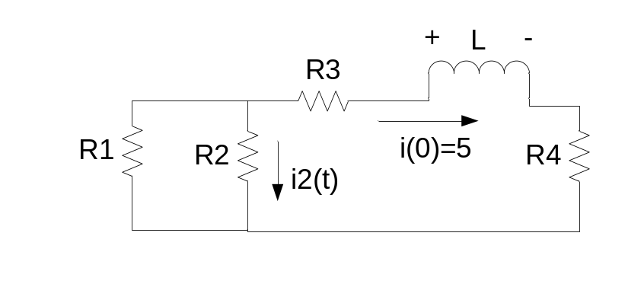
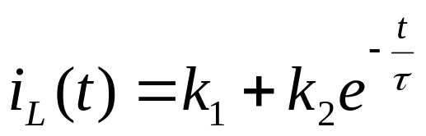
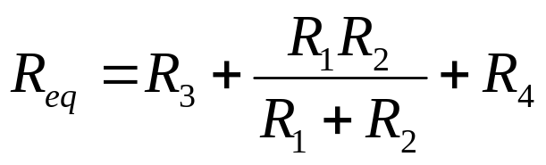
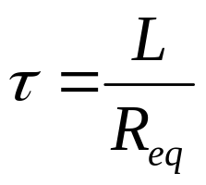
Example
L has an initial current of 5A at t=0
Find i2(t)
The current L is in form of
Time constant = R/L, find Req
(Thevenin’s)
Time constant

Slide 36
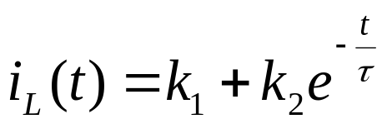
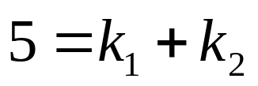
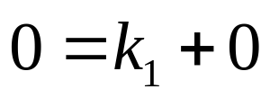
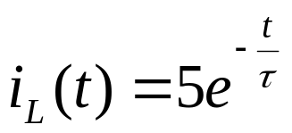

Find k1, k2 using i(0) = 5, i(∞) = 0
At t=0, i(0) = 5 A
At t = ∞, i(∞) = 0 A
Therefore, k1=0, k2 = 5
i2(t) comes from current divider of the inductor current
Graph?

Slide 37


Slide 38


Example
L stores no energy at t=0
Find v1(t)
Find i_{L}(t) first

Slide 39




Find k1, k2 using i(0) = 0, i(∞) = 0.25
At t=0, i(0) = 0 A
At t = ∞, i(∞) = 0.25 A
Therefore, k1=0.25, k2 = -0.25
v1(t) = i_{L}(t) R
Graph?

Slide 40



